Slide 1
Business Model Canvas
Notes:
- What we are learning this week

Slide 2
What is a Business Model Canvas?
One page summary
9 building blocks
High level
Capture and create value
Notes:
- Ask each participant

Slide 3
BMC vs. Traditional Business Plan
Long and time consuming
BMC first, then Business Plan
Doesn’t replace each other
Notes:
- Ask each participant

Slide 4
Notes:
Business Model Canvas that we will be working through. It has prompting questions to help you to answer each block

Slide 5
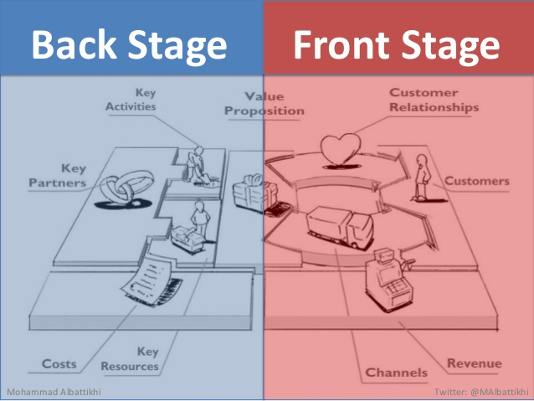
Business Model Canvas:
Notes:
Building blocks. Road map from where you are to where you need to be.
And we will walk through each one separately.

Slide 6
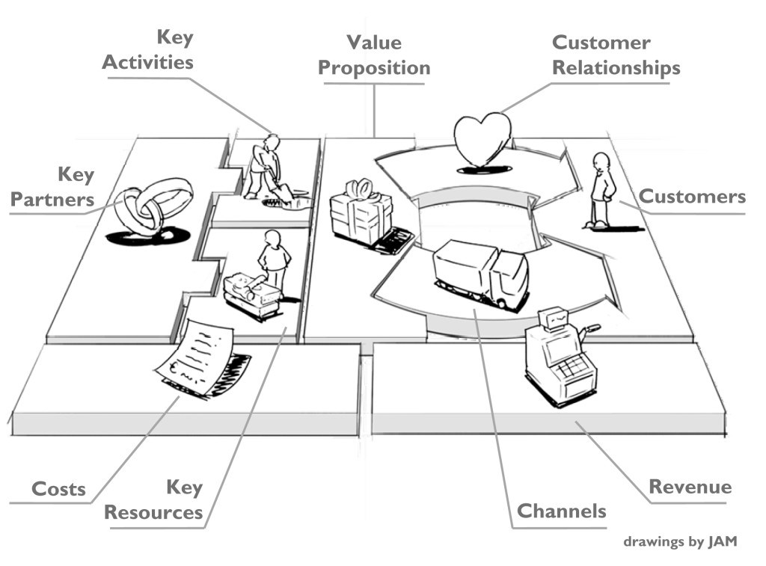
Business Model Canvas:
Notes:
Building blocks. Road map from where you are to where you need to be.
And we will walk through each one separately.

Slide 7
Notes:
The different groups of people or organizations who are looking to serve based on needs, behaviours, etc
Who are you creating value for?
Who are your most important customers?
Examples: Mass Market – Focus on everyone, Niche Market – cater to specific customers,

Slide 8
Customer Segments:
The different groups of people or organizations an enterprise aims to reach and serve
Group them into distinct segments with common needs behaviors, or other attributes
Know which segments to focus on and which to ignore
Who are you creating value for?

Slide 9
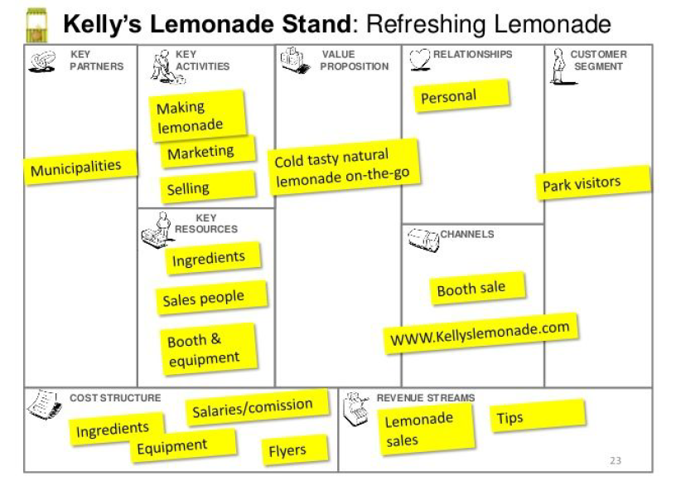
Notes:
Example of a completed BMC for Kelly’s Lemonade.

Slide 10
Notes:
Example of a completed BMC for Kelly’s Lemonade.

Slide 11
Notes:
The products and services that create value for a specific customer segment
The reason customers go to you over another company
It solves a customer problem or satisfies a need
- Examples: Newness – solves a new need that customers didn’t know they needed, Performance – improving a product, customization – ability to customize a product, Price

Slide 12
Value Proposition
The bundle of products and services that create value for a specific customer segment
The reason customers go to you over another company
It solves a customer problem or satisfies a need
Sometimes its innovative and other times it simply has an added benefit or features, attributes, newness, performance, customizes, price, convinces, etc

Slide 13
Notes:
Example of a completed BMC for Kelly’s Lemonade.

Slide 14
Notes:
Example of a completed BMC for Kelly’s Lemonade.

Slide 15
Notes:
How a company communicates with and reaches its customer segments to deliver the value proposition
customer touch points, which play an important role in the customer experience
How do your customer segments want to be reached,
Examples: Salesforce, websales, direct – sales force, indirect – partner stores.

Slide 16
Channels
How a company communicates with and reaches its customer segments to deliver the value proposition
A company interface with customers, customer touch points, which play an important role in the customer experience
Direct – online, owned retail
Indirect – partner retail

Slide 17
Notes:
Example of a completed BMC for Kelly’s Lemonade.

Slide 18
Notes:
Example of a completed BMC for Kelly’s Lemonade.

Slide 19
Notes:
The types of relationships a company establishes with a specific customer segment
Can range from personal to automated
What type of relationship do your customers expect? Personal assistance, self-serve, automated, etc.
Can change for each customer segment – old people vs. young people
- Examples: Personal assistance, self-service, Communities (good for tech businesses)

Slide 20
Customer Relationships
The types of relationships a company establishes with a specific customer segment
Can range from personal to automated
What type of relationship do your customers expect?
Personal assistance, self-serve, automated, etc.
What is driving it- customer acquisition, customer retention, boosting sales

Slide 21
Notes:
Example of a completed BMC for Kelly’s Lemonade.

Slide 22
Notes:
Example of a completed BMC for Kelly’s Lemonade.

Slide 23
Notes:
The cash a company generates from each customer segment
What is the customer truly willing to pay
Is there one or more revenue streams
- Examples: asset sale – selling a product , usage fee – phone example, subscription fees

Slide 24
Revenue Streams
The cash a company generates from each customer segment
What is the customer truly willing to pay
Is there one or more revenue streams
Several ways to generate your revenue- determine which is best
Usage fee, subscription model, renting, licensing, etc
COVID has changed revenue streams

Slide 25
Notes:
Example of a completed BMC for Kelly’s Lemonade.

Slide 26
Notes:
Example of a completed BMC for Kelly’s Lemonade.

Slide 27
Notes:
The most important assests required to make your business model work
- Examples: physical –manufacturing facilities, financial – cash , human – staff ex – sales force
What resources does your value proposition, distribution channels, customer relationships, revenue streams, etc need

Slide 28
Key Resources
The most important assets requires to make your business model work
Key resources can be physical, financial, intellectual, or human, and they can be owned, leased, or acquired from partners
What resources does your value proposition, distribution channels, customer relationships, revenue streams, etc need

Slide 29
Notes:
Example of a completed BMC for Kelly’s Lemonade.

Slide 30
Notes:
Example of a completed BMC for Kelly’s Lemonade.

Slide 31
Notes:
The most important things a company must do to make its business model work
What must you do to operate successfully and reach key markets, maintain customers, earn revenue, etc.
- Examples: Production – to deliver high end products, Problem solving – new solutions to customer problems

Slide 32
Key Activities
The most important things a company must do to make its business model work
What must you do to operate successfully and reach key markets, maintain customers, earn revenue, etc.
Which activities does each of the areas need?
Ie. Updating software, training, marketing

Slide 33
Notes:
Example of a completed BMC for Kelly’s Lemonade.

Slide 34
Notes:
Example of a completed BMC for Kelly’s Lemonade.

Slide 35
Notes:
The network of suppliers and partners that make the business model work
Help to optimize the business model, reduce risk, and acquire resources
- Examples: strategic alliance- between non-competitors, joint venture – develop a new business

Slide 36
Key Partners
The network of suppliers and partners that make the business model work
Partnerships are becoming a cornerstone of many businesses
Help to optimize the business model, reduce risk, acquire resources
Ie. Restaurant – sysco

Slide 37
Notes:
Example of a completed BMC for Kelly’s Lemonade.

Slide 38
Notes:
Example of a completed BMC for Kelly’s Lemonade.

Slide 39
Notes:
The cost structure describes all the costs incurred to operate a business model.
- Examples: Cost-driven (minimizing costs anywhere no frills, ), value-driven (luxury products),

Slide 40
Cost Structure
Most important costs incurred while operating
Creating and delivering value, maintaining Customer Relationships, and generating revenue all incur costs.
Cost-driven vs. Value-driven
Some business models, though, are more cost-driven than others. So-called “no frills” airlines, for instance, have built business models entirely around low-Cost Structures.

Slide 41
Notes:
Example of a completed BMC for Kelly’s Lemonade.

Slide 42
Notes:
Example of a completed BMC for Kelly’s Lemonade.

